Slide 1
Course : COMP8043 – Machine Learning
Period : September 2020
Model Evaluation and Ensemble Learning
Session 10
KDS – Amalia Zahra, S.Kom., Ph.D.

Slide 2



Slide 3
Learning Outcomes
After the completion of this session, students are expected to achieve the following learning outcomes:
LO4: Analyze the results obtained from Machine Learning experiments from several perspectives.
LO5: Able to propose suggestions to improve the system performance.

Slide 4
Session Outcomes
By completing this session, you will be able to:
Describe the concept of evaluation and its issues
Compute performance evaluation metrics for regression and classification
Describe the concept of parameter tuning
Perform holdout validation, cross validation, and model comparison.
Describe three ensemble methods: bagging, boosting, and stacking

Slide 5
Topics
Basic Issues
Performance Evaluation Metrics for Regression
Performance Evaluation Metrics for Classification
Parameter Tuning
Holdout Validation
Cross Validation
  Cross Validation vs Bootstrap
Model Comparison
Ensemble Methods: Bagging, Boosting, Stacking

Slide 6
Evaluation is the key to making real progress in data mining
[Witten &. Frank, 2005], p.143

Slide 7
BASIC ISSUES

Slide 8
Credibility Issues
How much should we believe in what was learned?
  New data ≠ the training data!
  Error on the training data is not a good indicator of performance on new data.
How predictive is the model we learned in practice?
  Overfitting: fitting the training data too precisely usually leads to poor results on new data.

Slide 9
Model Evaluation
How to evaluate classifier’s performance?
  Use metrics
How to obtain good performance indicators?
  Use training-testing schemes
How to compare different models?
  Use lift charts, ROC curve
Given equally performing models, which one should we prefer?
  Use MDL principle

Slide 10
PERFORMANCE EVALUATION METRICS FOR REGRESSION

Slide 11
Measuring the Fit of Linear Regression Model
How well variable x predicts the variable y?
y
y = wx + b
x

Slide 12
Measuring the Fit of Linear Regression Model
SSR = Regression Sum of Squares.
  Explained variation attributable to the relationship between X and Y
SSE = Error Sum of Squares
  Variation attributable to factors other than the relationship between X and Y
SST = Total Sum of Squares
  Measures the variation of the Yi values around their mean, Ӯ

Slide 13
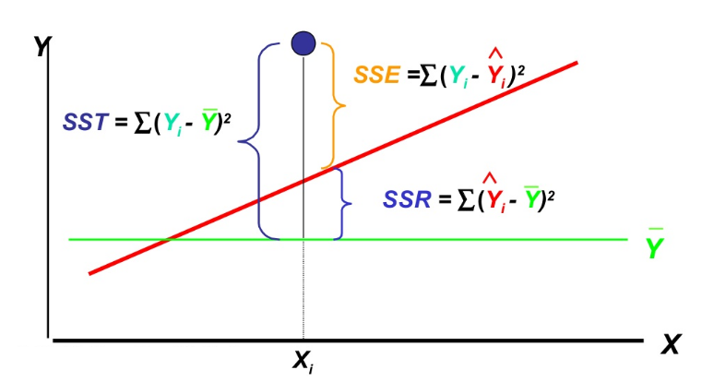
Measuring the Fit of Linear Regression Model

Slide 14
Measuring the Fit of Linear Regression Model
Other measurements:
Correlation coefficient (r)
  Strength of relationship between X and Y variables
Coefficient of determination (r²)
  Proportion of explained variation
Standard Error
  Standard deviation of error around the regression line
Residual analysis
  Validation of model

Slide 15
PERFORMANCE EVALUATION METRICS FOR CLASSIFICATION

Slide 16
Performance Evaluation for Classification: Confusion Matrix
It compares predicted class from the model outcomes and actual class
 |  | PREDICTED CLASS
 |  | Classified as pos (+) | Classified as neg (-)
DATA CLASS | nos (+) | true positives (TP) | false negatives (FN)
 | neg (-) | false positives (FP) | true negatives (TN)

Slide 17
Case:
Healthcare Disease Diagnostic
Once doctor identifies the disease (based on the test results and symptom), relevant drugs and medication could be given to the patients.
 |  | PREDICTED CLASS
 |  | Class=Patients classified to have disease | Class=Patients classified as free from disease
DATA CLASS | Class=Patients have disease | TP (Patients correctly identified to have disease) | FN (Patients have been left out from treatment for disease)
 | Class=Patients do not have disease | FP (Patients wrongly identified to have disease) | TN (Patients correctly have been left out from treatment for disease)

Slide 18
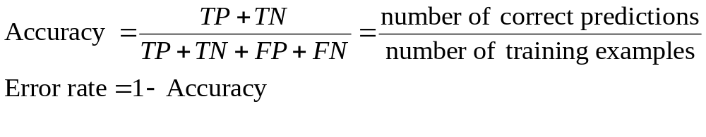
Accuracy
Measures overall effectiveness of a classifier
Mostly used performance metric
    Proportion of errors made over the whole set of instances

Slide 19
Some Issues with Accuracy
Class imbalance problem
  Number of Class 0 examples = 9990
  Number of Class 1 examples = 10
If model predicts everything to be class 0, accuracy is 9990/10000 = 99.9 %
  Accuracy is misleading because model does not detect any class 1 example.

Slide 20
In Healthcare: Disease Diagnostic Case
True positives, true negatives
  a doctor suggests relevant drugs and medication for the sick patients
  a patient can go back home safely
False positive
  Wrong medical treatment for patients
  Hospital/doctor can be accused
False negative
  Patients’ disease left out without any treatment
  Hospital/doctor loose profit, trust

Slide 21
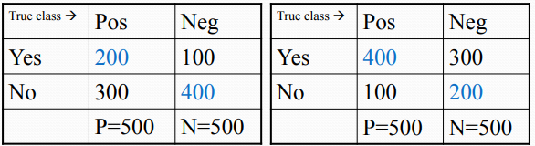
Some Issues with Accuracy
Both classifiers obtain 60% accuracy
They exhibit very different behaviors:
  On the left: weak positive recognition rate/strong negative recognition rate
  On the right: strong positive recognition rate/weak negative recognition rate

Slide 22
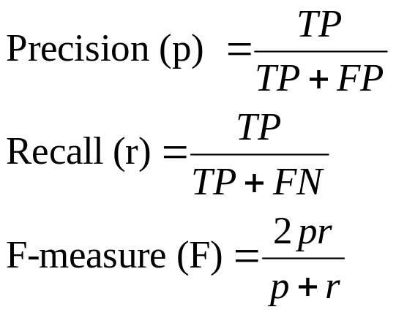
Alternatives to Accuracy
Precision (p) - measure classifier’s exactness (low value means large FP)
Recall (r) - measure classifier’s completeness (low value means large FN)
F-measure (also known as F1 score) - balance the precision and the recall

Slide 23
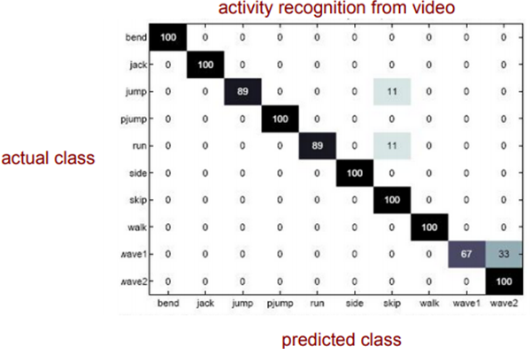
Confusion Matrix for Multiclass
Example of multiple classification for computer vision problem:
figure from vision.jhu.edu

Slide 24
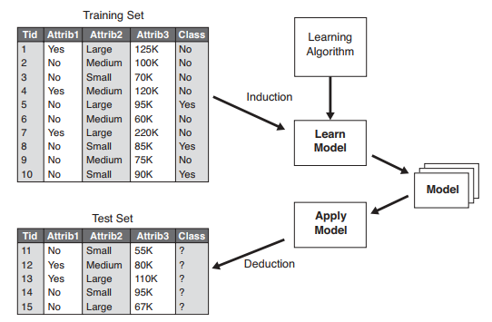
Methods for Performance Evaluation
How to obtain a reliable estimate of the performance of a learned model?
  Use training-test classification schemes

Slide 25
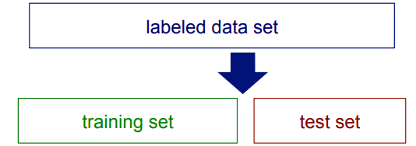
Classification Step 1
Split the data into train and test sets

Slide 26
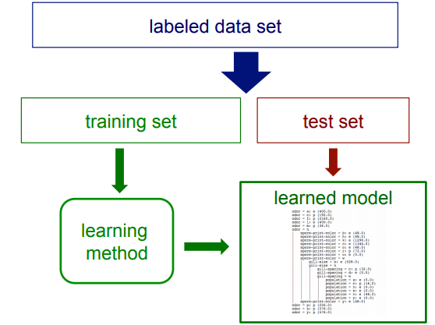
Classification Step 2
Train a model using the data in the training set

Slide 27
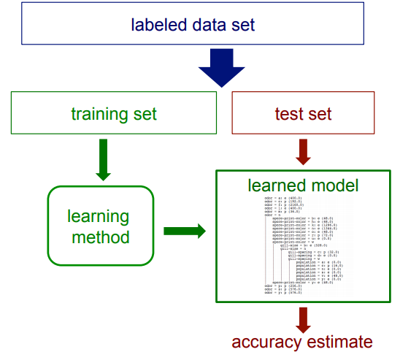
Classification Step 3
Evaluate the accuracy (or other performance metrics) of the learned model using the data in test set

Slide 28
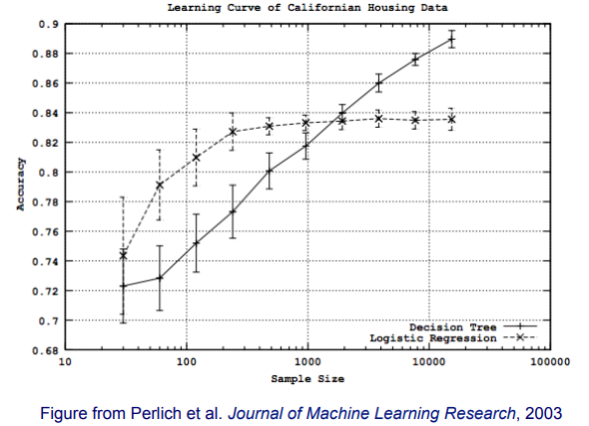
An example:
Decision Tree and Logistic Regression
How does the accuracy of a learning method on test set change as a function of the training-set size?

Slide 29
PARAMETER TUNING

Slide 30
Parameter Tuning
It is important that the test data is not used in any way to create the classifier.
Some learning schemes operate in two stages:
    Stage 1: build the basic structure
    Stage 2: optimize parameter settings
Proper procedure uses three sets: training data, validation data, and test data
    Validation data is used to optimize parameters
The test data cannot be used for parameter tuning!

Slide 31
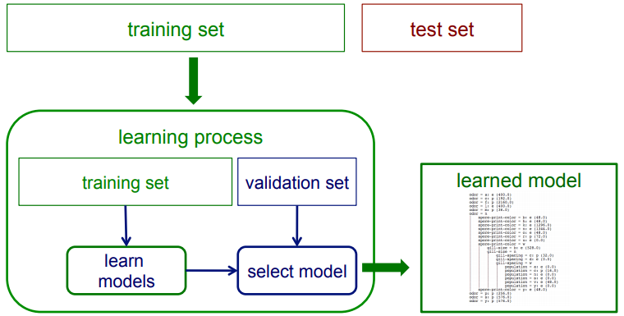
Parameter Tuning with Validation Set
    How to select good model (optimized parameters) by splitting training data into separate training and validation sets.

Slide 32
Model Validation Techniques
Holdout
  Reserve 1/2 for training and 1/2 for testing
  Reserve 2/3 for training and 1/3 for testing
Random subsampling
  Repeated holdout
Cross validation
  Partition data into k subsets
  k-fold: train on k-1 partitions, test on the remaining one
  Leave-one-out: k=n

Slide 33
HOLDOUT VALIDATION

Slide 34
Holdout Technique
Reserves a certain amount for testing and uses the remainder for training
  Reserve 1/2 for training and 1/2 for testing
  Reserve 2/3 for training and 1/3 for testing
For small or unbalanced datasets, samples might not be representative
    Example: a class might be missing in the test data

Slide 35
Repeated Holdout Technique
Holdout estimate can be made more reliable by repeating the process with different subsamples
    In each iteration, a certain proportion is randomly selected for training (possibly with stratification).
    The error rates on the different iterations are averaged to yield an overall error rate.

Slide 36
CROSS VALIDATION

Slide 37
Cross-Validation Technique
K-fold cross-validation avoids overlapping test sets
    First step: split data into k subsets of equal size (called as folds).
    Second step: use each subset in turn for testing, the remainder for training.
    This means the learning algorithm is applied to k different training sets
The error estimates are averaged to yield an overall error estimate
  standard deviation is often computed.

Slide 38
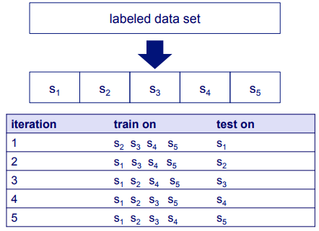
Cross-Validation Technique
k-fold cross-validation avoids overlapping test sets
    First step: split data into k subsets of equal size (called as folds).
    Second step: use each subset for testing, the remainder for training.
    This means the learning algorithm is applied to k different training sets.

Slide 39
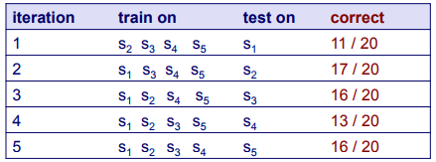
Cross-Validation Example
Suppose we have 100 instances, and we want to estimate accuracy with cross validation
    accuracy = 73/100 = 73%

Slide 40
Cross-Validation Technique
Standard method for evaluation: stratified ten-fold cross-validation.
Why ten?
    Extensive experiments have shown that this is the best choice to get an accurate estimate
    There is also some theoretical evidence for this
Stratification reduces the estimate’s variance
Even better: repeated stratified cross-validation
    E.g., ten-fold cross-validation is repeated ten times and results are averaged (reduces the variance)

Slide 41
Leave-One-Out Cross-Validation
A particular form of k-fold cross-validation:
    Set number of folds to number of training instances.
    i.e., for n training instances, build classifier n times.
Makes best use of the data.
Involves no random subsampling.
Very computationally expensive (exception: using lazy classifiers such as the nearest-neighbor classifier).

Slide 42
Leave-One-Out Cross-Validation
Disadvantage of leave-one-out CV: stratification is not possible.
    It guarantees a non-stratified sample because there is only one instance in the test set!
Extreme example: random dataset split equally into two classes
    Best inducer predicts majority class
    50% accuracy on fresh data
    Leave-one-out CV estimate gives 100% error!

Slide 43
Bootstrap Technique
CV uses sampling without replacement.
    The same instance, once selected, can not be selected again for a particular training/test set
The bootstrap uses sampling with replacement to form the training set.
    Sample a dataset of n instances n times with replacement to form a new dataset of n instances.
    Use this data as the training set.
    Use the instances from the original dataset that do not occur in the new training set for testing.

Slide 44
MODEL COMPARISON

Slide 45
ROC
(Receiver Operating Characteristic)
Developed in 1950s to analyze noisy signals.
  Characterize the trade-off between positive hits and false alarms.
ROC curve plots TP (y-axis) against FP (x-axis).
Performance of each classifier represented as a point on the ROC curve.
  changing the threshold of algorithm, sample distribution or cost matrix changes the location of the point.

Slide 46
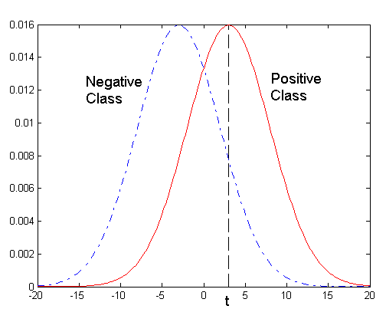
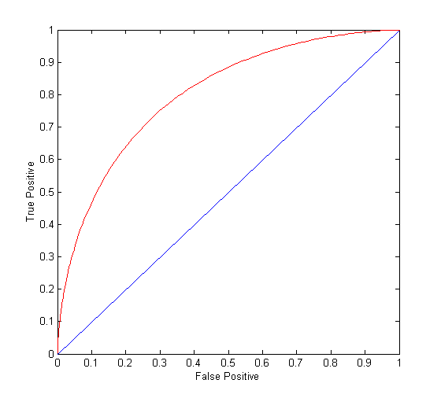
ROC Curve
1D data set containing 2 classes (positive and negative).
Any points located at x > t is classified as positive.
At threshold t:
TP=0.5, FN=0.5, FP=0.12, FN=0.88

Slide 47
ROC Curve
(TP,FP):
(0,0): declare everything
to be negative class
(1,1): declare everything
to be positive class
(1,0): ideal
Diagonal line:
  Random guessing
  Below diagonal line:
    prediction is opposite of the true class

Slide 48
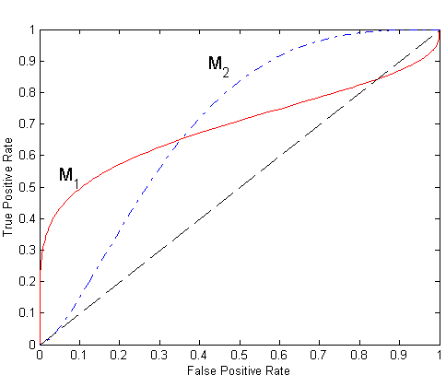
Using ROC for Model Comparison
No model consistently outperforms the other,
  M₁ is better for small FPR.
  M₂ is better for large FPR.
Area Under the ROC curve
  Ideal:
    Area = 1
  Random guess:
    Area = 0.5

Slide 49
How to Construct an ROC curve
Instance | P(+|A) | True Class
1 | 0.95 | +
2 | 0.93 | +
3 | 0.87 | -
4 | 0.85 | -
5 | 0.85 | -
6 | 0.85 | +
7 | 0.76 | -
8 | 0.53 | +
9 | 0.43 | -
10 | 0.25 | +
Use classifier that produces posterior probability for each test instance P(+|A).
Sort the instances according to P(+|A) in decreasing order.
Apply threshold at each unique value of P(+|A).
Count the number of TP, FP, TN, FN at each threshold.
TP rate, TPR = TP/(TP+FN)
FP rate, FPR = FP/(FP + TN)

Slide 50
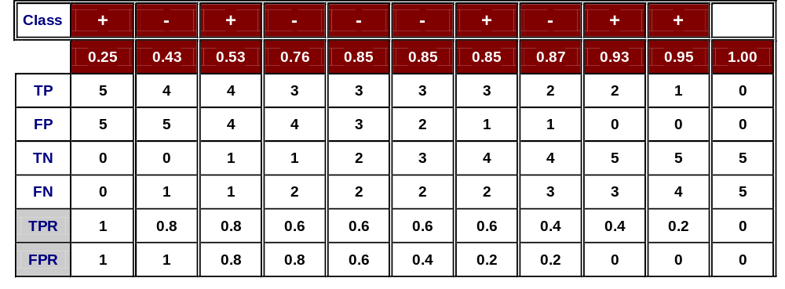
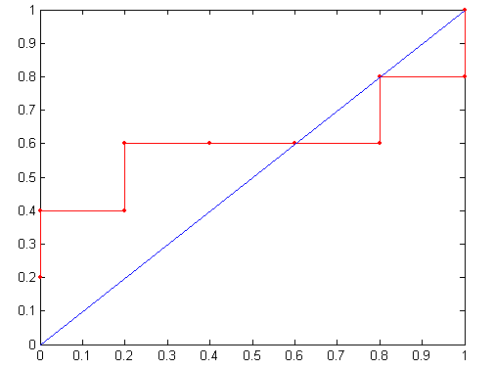
How to Construct an ROC curve
Threshold >=
ROC Curve

Slide 51
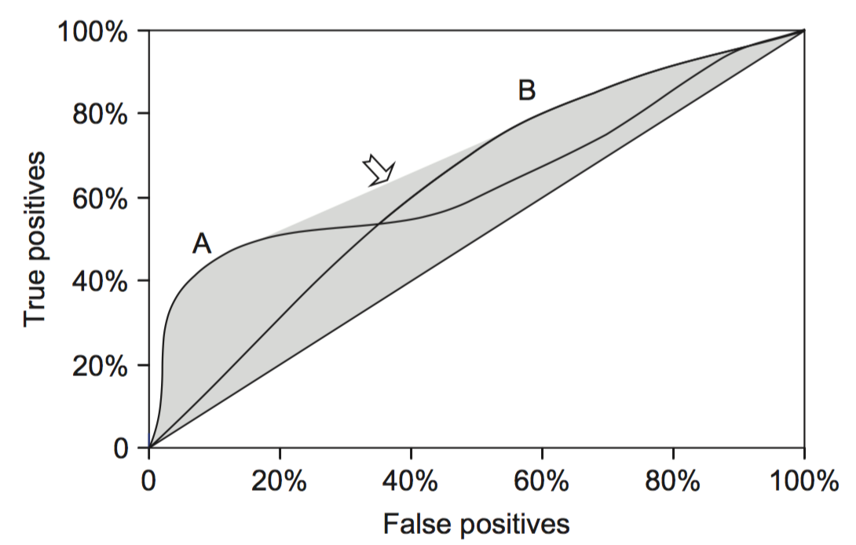
ROC Curves for Two Schemes
For a small, focused sample, use method A.
For a larger one, use method B.
In between, choose between A and B with appropriate probabilities.

Slide 52
Test of Significance
Given two models:
  Model M1: accuracy = 85%, tested on 30 instances
  Model M2: accuracy = 75%, tested on 5000 instances
Can we say M1 is better than M2?
  How much confidence can we place on accuracy of M1 and M2?
  Can the difference in performance measure be explained as a result of random fluctuations in the test set?

Slide 53
Performance Evaluation of Clustering Algorithms
(for session 8)
Internal criterion
  Criteria are derived from the data itself.
  e.g. intra-cluster and inter-cluster distances to measure cluster compactness and separation.
External Evaluation
  Criteria are not inherent to the variables in the cluster dataset.
  e.g. class labels for each point.

Slide 54
Internal Criterion
Sec. 16.3
A good clustering will produce high quality clusters in which:
  the intra-class (that is, intra-cluster) similarity is high.
  the inter-class similarity is low.
  The measured quality of a clustering depends on both the document representation and the similarity measure used.
  e.g. BetaCV ratio, C-index, Dunn index.

Slide 55
External Criteria
Sec. 16.3
Quality measured by its ability to discover some or all of the hidden patterns or latent classes in gold standard data.
Assesses a clustering with respect to ground truth … requires labeled data.
Assume documents with C gold standard classes, while our clustering algorithms produce K clusters, ω₁, ω₂, …, ω_{K} with n_{i} members.

Slide 56

External Evaluation
Sec. 16.3
Simple measure: purity, the ratio between the dominant class in the cluster π_{i} and the size of cluster ω_{i}
Biased because having n clusters maximizes purity.
Others are entropy of classes in clusters (or mutual information between classes and clusters).

Slide 57
Purity Example
Sec. 16.3
• •
• •
• •
• •
• •
• •
• •
• •
•
Cluster I
Cluster II
Cluster III
Cluster I: Purity = 1/6 (max(5, 1, 0)) = 5/6
Cluster II: Purity = 1/6 (max(1, 4, 1)) = 4/6
Cluster III: Purity = 1/5 (max(2, 0, 3)) = 3/5

Slide 58
Rand Index measures between pair decisions. Here RI = 0.68
Sec. 16.3
Number of points | Same Cluster in clustering | Different Clusters in clustering
Same class in ground truth | 20 | 24
Different classes in ground truth | 20 | 72

Slide 59
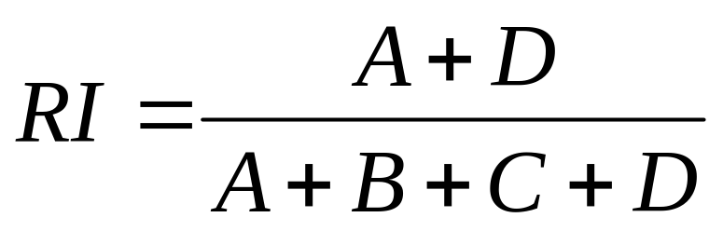
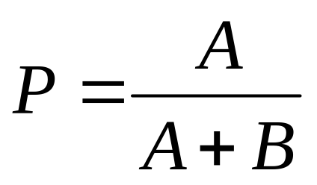
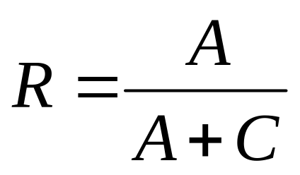
Rand Index and Cluster F-Measure
Sec. 16.3
Compare with standard Precision and Recall:
People also define and use a cluster F-measure, which is probably a better measure.

Slide 60
ENSEMBLE METHODS

Slide 61
Ensemble Methods
Ensemble learning is a machine learning paradigm where multiple models (often called “weak learners”) are trained to solve the same problem and combined to get better results.
Hypothesis: When weak models are correctly combined, we can obtain more accurate and/or robust models.

Slide 62
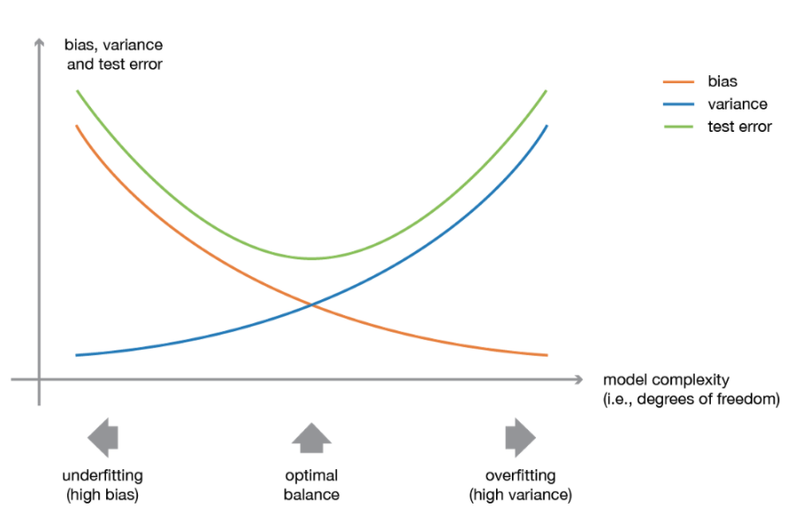
Motivation Behind Ensemble Methods
Basics models (weak learners) perform not so well by themselves either because they have a high or too much variance to be robust.
The idea of ensemble methods: try reducing bias and/or variance of such weak learners by combining several of them together in order to create a strong learner that achieves better performances.
3 types of ensemble methods:
  → Bagging, Boosting, Stacking

Slide 63
1. Bagging
Bagging: Bootstrap aggregating.
Use homogenous weak learners, which can be parallelized.
Mainly focus at getting an ensemble model with less variance.
Bagging consists of 2 processes:
  Bootstrapping
  Aggregating

Slide 64
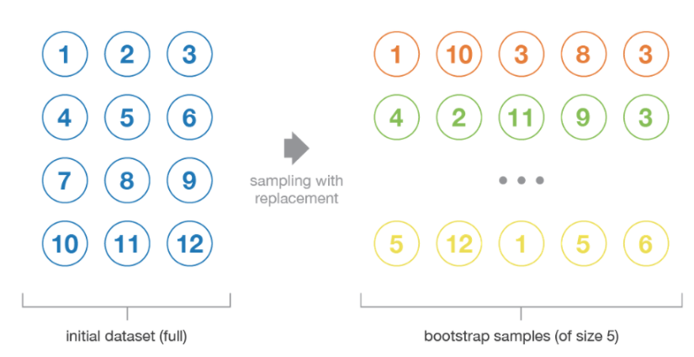
Bootstrapping

Slide 65
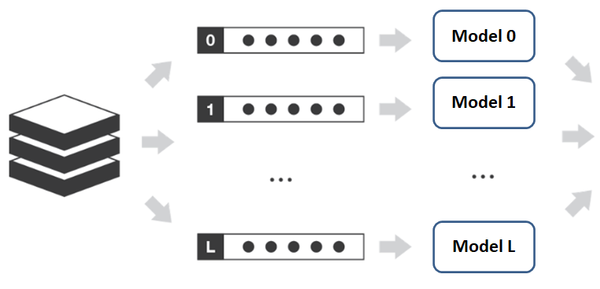
Bagging Process
aggregating
Initial dataset
L+1 bootstrap samples
L+1 models/
weak learners
(homogenous)

Slide 66
Aggregating
For a regression problem:
  Outputs of individual models are averaged to obtain the output of the ensemble method.
For a classification problem:
  Take a vote on the classes generated by the individual models (hard-voting)
  Probabilities of each class produced by individual models are averaged. Take the class that has the highest average probability (soft-voting)

Slide 67
2. Boosting
Also use homogenous weak learners like in Bagging, but performed in sequential.
It models iteratively such that the training of model at a given step depends on the models fitted at the previous steps.
Mainly focus at getting an ensemble model with less bias (even if variance can also be reduced).

Slide 68
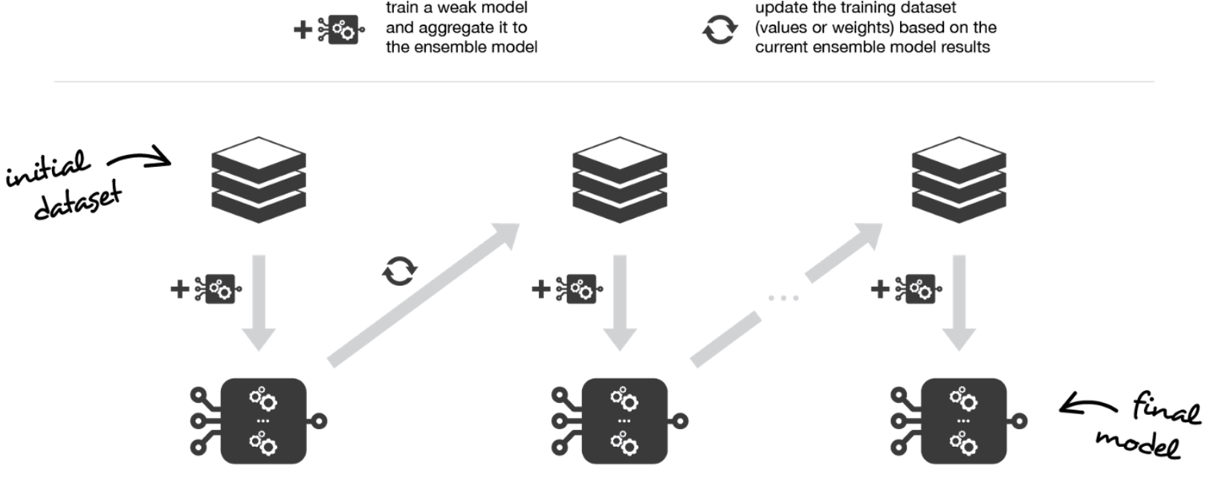
Boosting Illustration
https://towardsdatascience.com/ensemble-methods-bagging-boosting-and-stacking-c9214a10a205
2 boosting algorithms: adaptive boosting (AdaBoost) & gradient boosting

Slide 69
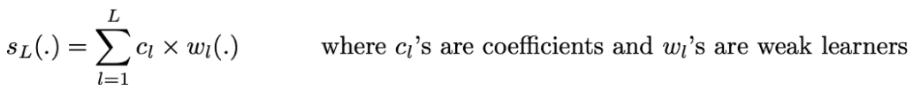
AdaBoost
The ensemble model is considered as a weighted sum of L weak learners.
Steps of AdaBoost:
  Assign the same weight for all observations.
  Fit the best possible weak model with the current observations weights.
  Compute the value of the update coefficient that is scalar evaluation metric of the weak learner that indicates how much this weak learner should be taken into account into the ensemble model.
  Update the strong learner by adding the new weak learner multiplied by its update coefficient.
  compute new observations weights that express which observations we would like to focus on at the next iteration (weights of observations wrongly predicted by the aggregated model increase and weights of the correctly predicted observations decrease).
Repeating these steps until we have built sequential L models and aggregate them into a simple linear combination weighted by coefficients expressing the performance of each learner.

Slide 70
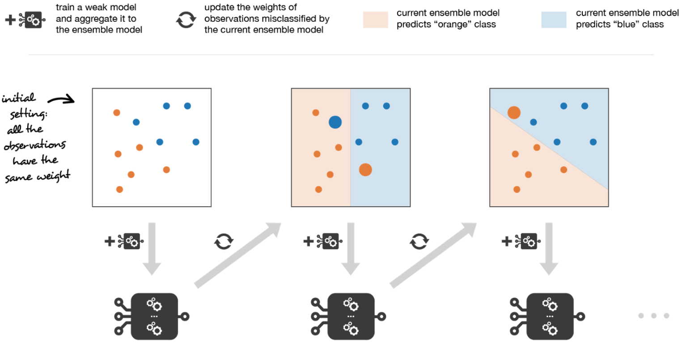
AdaBoost Illustration
Adaboost updates weights of the observations at each iteration. Weights of well classified observations decrease relatively to weights of misclassified observations. Models that perform better have higher weights in the final ensemble model.
https://towardsdatascience.com/ensemble-methods-bagging-boosting-and-stacking-c9214a10a205

Slide 71
Gradient Boosting
In AdaBoost, the observation weights are updated, while in Gradient Boosting, the observation values are.
Gradient boosting casts the sequential optimization problem into a gradient descent one.

Slide 72
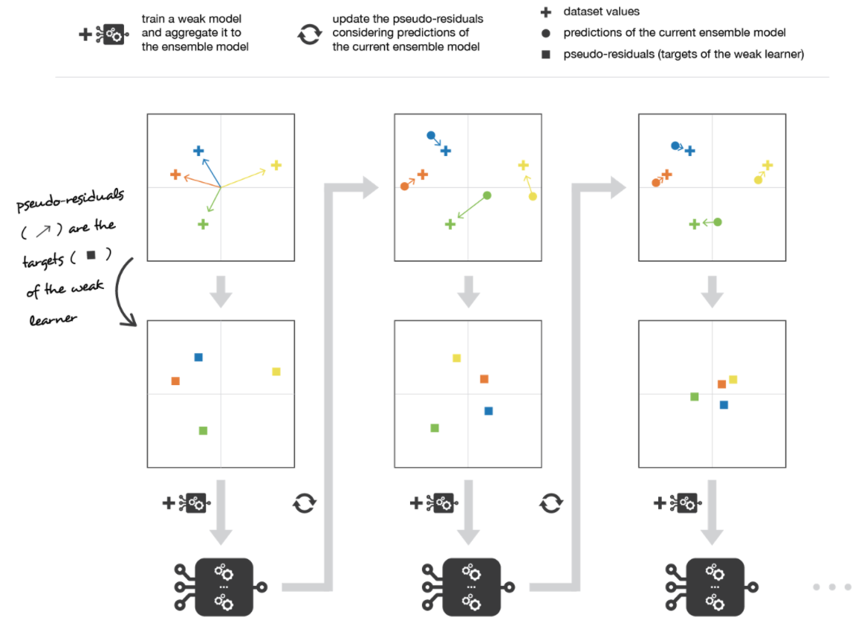
Gradient Boosting Illustration
Gradient boosting updates values of the observations at each iteration. Weak learners are trained to fit the pseudo-residuals that indicate in which direction to correct the current ensemble model predictions to lower the error.
https://towardsdatascience.com/ensemble-methods-bagging-boosting-and-stacking-c9214a10a205

Slide 73
3. Stacking
Use heterogenous weak learners.
It learns to combine the base models by training a meta-model.
  Example: KNN classifier, a logistic regression and a SVM are chosen as weak learners (base models), and decide to learn a neural network (NN) as meta-model. Outputs of the three weak learners become the inputs of the NN to generate final output.
Like Boosting, Stacking also mainly focuses at getting an ensemble model with less bias (even if variance can also be reduced).

Slide 74
Steps of Stacking
Split the training data in two folds.
Choose L weak learners and fit them to data of the first fold.
For each of the L weak learners, make predictions for observations in the second fold.
Fit the meta-model on the second fold, using predictions made by the weak learners as inputs.
Drawback: only half the training data used to train the base models and half used to train the meta-model.
  Solution: k-fold cross training (similar to k-fold cross validation)

Slide 75
Summary of Ensemble Methods
Ensemble learning is a machine learning paradigm where multiple models (often called weak learners or base models) are trained to solve the same problem and combined to get better performances.
In bagging methods, several instances of the same base model are trained in parallel (independently from each others) on different bootstrap samples and then aggregated in some kind of “averaging” process.
In boosting methods, several instances of the same base model are trained sequentially such that, at each iteration, the way to train the current weak learner depends on the previous weak learners and more especially on how they are performing on the data.
In stacking methods, different weak learners are fitted independently from each others and a meta-model is trained on top of that to predict outputs based on the outputs returned by the base models.

Slide 76
References
Bishop, C. M. (2006). Pattern recognition and machine learning. springer.
Flach, P. (2012). Machine learning: the art and science of algorithms that make sense of data. Cambridge University Press.
https://towardsdatascience.com/ensemble-methods-bagging-boosting-and-stacking-c9214a10a205

Slide 77
Q&A

Slide 78


